Slide 1
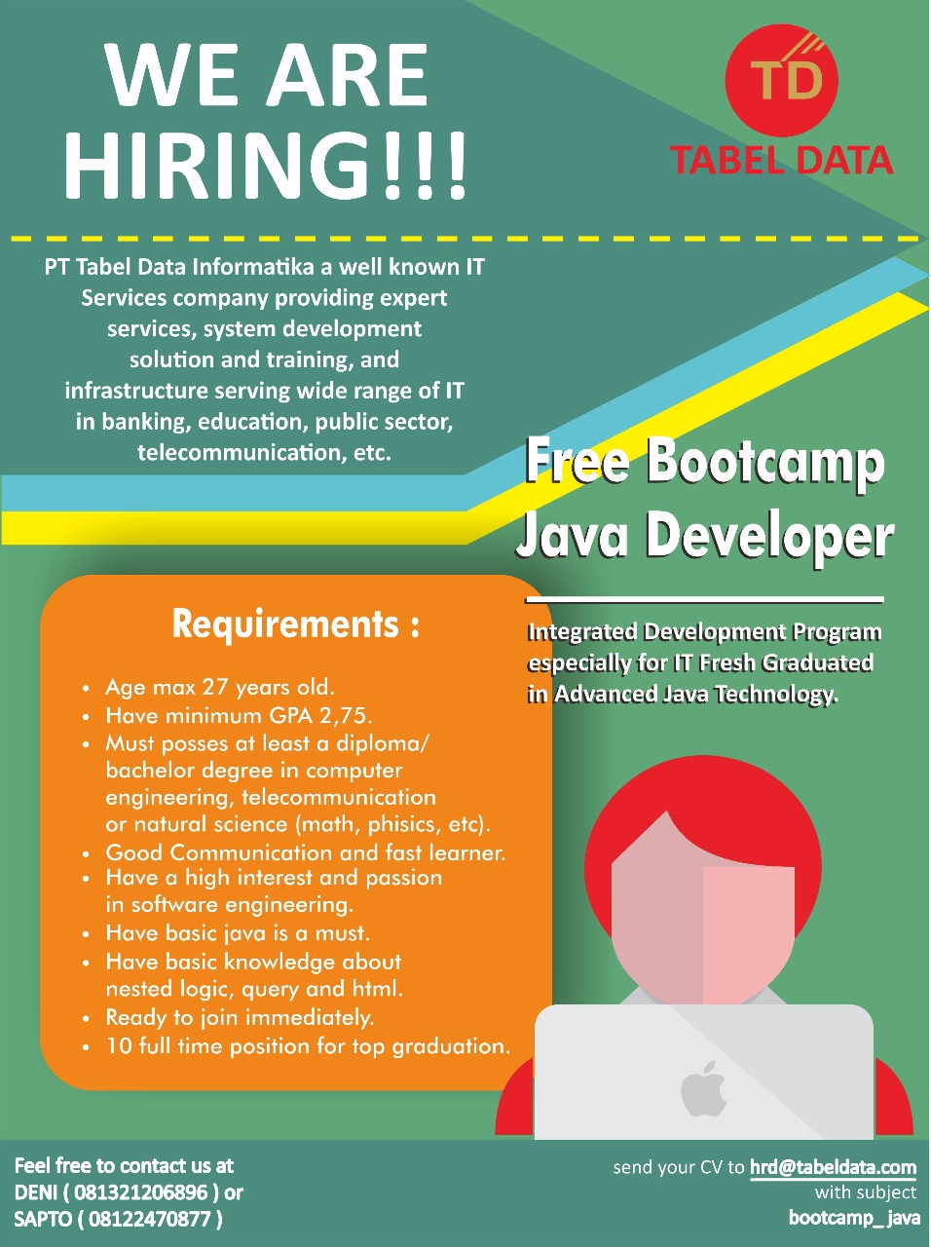
Bootcamp Java Developer #Day 1
PT. Tabel Data Infromatika
By Dimas Maryanto,S.Kom

Slide 2
Teknologi WEB
Hyper Text Mark Language (HTML)
Cascading Style Sheets
Scripting Language
Server Side
Client Side
Methode Aplikasi Web
Action Based
Request/Response Based

Slide 3




Server Side Teknologi

Slide 4
Teknologi Server Side di Java
Request/Action Based
Java EE
Spring Framework
Play Framework
Grails Framework
dll
Action Based
ZKoss
Vaadin
Primefaces
dll

Slide 5
Client Side Teknologi
JavaScript
EmberJS
JQuery
Typescript
Angular2
HTML
CSS
Bootstrap
Materialize

Slide 6





Pemilihan Teknologi?
Server Side:
Java
Spring Framework
Hibernate ORM
Client Side:
Javascript
Typescript
Angular2

Slide 7




Web Server untuk Java

Slide 8



Text Editor / IDE
Netbeans / IntelliJ IDEA / Eclipse (Java Code)
Microsoft Studio Code / Webstrom (Javascript Code)

Slide 9
Project Akhir
Membuat aplikasi sederhana untuk perbankan dengan modul
Tabungan
Deposito
Kredit

